Slide 1

EVENT PLANNING CHATBOT USING DEEP LEARNING (LSTM)
Presented By:
Name: BALAJI E
Email: balajielangovan05@gmail.com
Reg. no.: 422521104006
College: University College Of Engineering Villupuram.

Slide 2
Problem Statement
Project Overview
Proposed solution
System Requirements
Model
Result
Conclusion
References
AGENDA

Slide 3
PROBLEM STATEMENT
In the event planning industry, professionals often face challenges in efficiently organizing and managing various aspects of events. The time-consuming nature of manual coordination processes can lead to inefficiencies, errors, and delays in event planning. Therefore, there is a need for an Event Planning Chatbot that can automate tasks, provide personalized recommendations and enhance overall event management processes. By leveraging advanced technologies such as Natural Language Processing (NLP) and machine learning algorithms.

Slide 4
PROJECT OVERVIEW
Our project involves creating an Event Planning Chatbot using advanced NLP and machine learning techniques to automate event organization tasks. The chatbot understands user inputs like event details, participant information, and budget constraints, generating intelligent responses and recommendations. By leveraging LSTM networks, it retains context during conversations, ensuring coherent interactions and personalized assistance. Integrating with event systems, the chatbot facilitates real-time collaboration and enhances efficiency in event planning processes. Our goal is to provide a seamless and efficient solution that revolutionizes the event planning experience for both organizers and participants.

Slide 5
PROPOSED SOLUTION
Natural Language Processing (NLP): The idea here is to employ NLP techniques such as tokenization and lemmatization to process and understand natural language inputs.
Tokenization: The code uses tokenization to break down sentences or phrases into individual words or tokens.
Lemmatization: Lemmatization is employed to reduce words to their base or root form.
Neural Network Architecture: We defines a neural network architecture using Keras, with layers such as Embedding, LSTM, Dense, and Dropout, to create a model capable of learning patterns and generating responses.

Slide 6
SYSTEM REQUIREMENTS
Hardware Requirements:
Processor: Any modern processor (e.g., Intel Core i5 or AMD Ryzen 5) capable of handling computational tasks efficiently.
Memory (RAM): Minimum 8GB RAM is recommended for smooth execution, especially during model training.
Storage: Adequate storage space to store the code files, datasets, and libraries (at least 10GB free space).
Graphics Processing Unit (GPU) (Optional):A dedicated GPU, such as NVIDIA GeForce GTX or AMD Radeon, can significantly accelerate the training process for deep learning models like LSTM networks. However, it is not strictly required for running the code.

Slide 7
SYSTEM REQUIREMENTS – CONT.
Software Requirements:
Python: The project is implemented using Python 3.x (e.g., Python 3.6, 3.7, 3.8) is required.
JSON Data File: Ensure you have a JSON file named 'dataset1.json' containing intents, patterns, and responses for the chatbot.
NumPy: NumPy is used for numerical computations and array operations in Python. More than NumPy version 1.21.4 is required.
NLTK (Natural Language Toolkit): NLTK is a library for natural language processing tasks such as tokenization, lemmatization, stemming, and more. More than NLTK version 3.6.5 is required.
Keras and TensorFlow: Keras is a high-level neural networks API, and TensorFlow is a deep learning framework used as Keras’s backend. More than Keras version 2.6.0 is required.

Slide 8
MODEL
Data Preprocessing:
Tokenization: The nltk.word_tokenize() function from the NLTK library is used to tokenize (split into words) the text data. This step breaks down sentences or phrases into individual words, which are then processed further.
Lemmatization: Lemmatization is the process of reducing words to their base or root form. The code initializes a WordNet Lemmatizer(WordNetLemmatizer() from NLTK) and applies it to each word in the tokenized text using list comprehension. For example, words like "running," "ran," and "runs" would all be lemmatized to their base form "run."
Bag of Words Representation: The processed words are then used to create a "bag of words" representation for each document (pattern). This representation counts the frequency of each word in the document and converts it into a numerical vector.

Slide 9
MODEL – CONT.
Model Building: The code defines a sequential model using Keras. The model consists of an Embedding layer, two LSTM (Long Short-Term Memory) layers, and two Dense layers. The Embedding layer converts words into dense vectors, which are then fed into the LSTM layers for learning sequential patterns in the data. The Dense layers are used for classification, with the final layer using softmax activation for multi-class classification.
Model Training: The model is compiled with the Adam optimizer and categorical cross-entropy loss function. It is then trained on the prepared training data for a specified number of epochs and batch size.
Model Evaluation: After training, the model's performance is evaluated on the training data to check accuracy.
Chatbot Interaction: Finally, the code allows interaction with the chatbot. It takes user input, processes it similar to how training data was preprocessed, predicts the intent using the trained model, and generates a response based on the predicted intent.

Slide 10
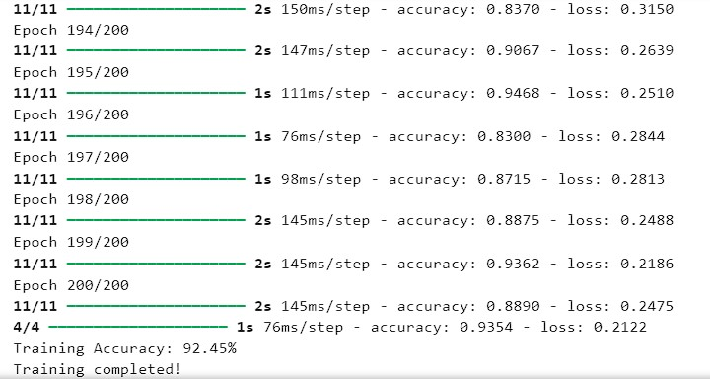
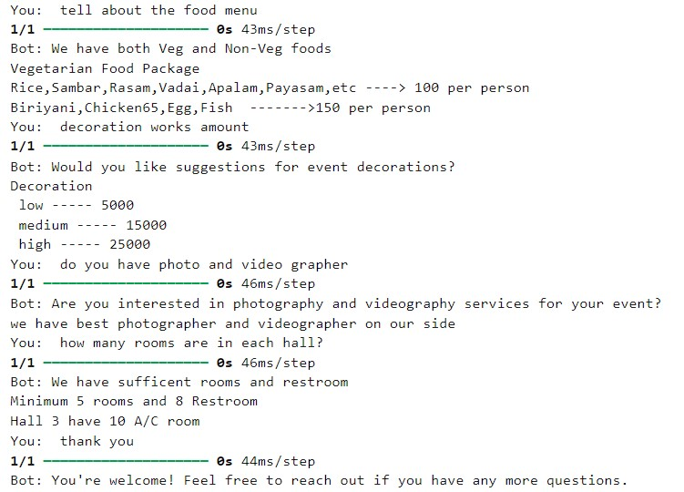
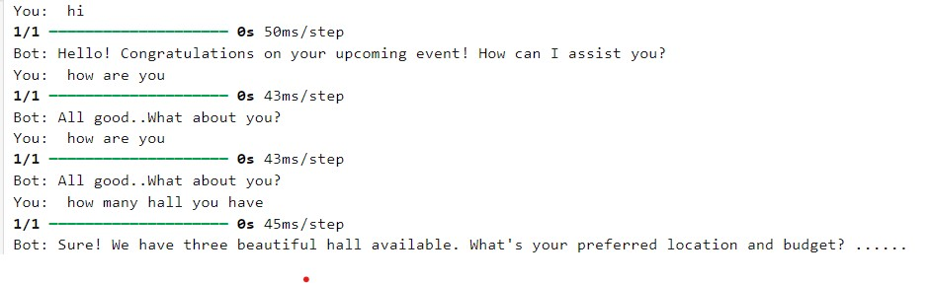
RESULT

Slide 11
CONCLUSION
In conclusion, the development of the Event Planning Chatbot utilizing machine learning and natural language processing techniques has been a significant endeavor. Through extensive data preprocessing, training data preparation, and model training, we have successfully created a chatbot capable of understanding and responding to user queries regarding event planning. The integration of LSTM networks, word lemmatization, and deep learning architectures has resulted in a highly accurate and responsive system. Moving forward, continuous refinement and expansion of the chatbot's capabilities will enhance its usability and effectiveness in assisting users with event planning tasks.

Slide 12
REFERENCES
Keras Documentation. (https://keras.io)
NLTK Documentation. (https://www.nltk.org)
TensorFlow Documentation. (https://www.tensorflow.org)
Research paper. (https://www.researchgate.net/publication/372132271_ChatGPT_in_Practice_Increasing_Event_Planning_Efficiency_Through_Artificial_Intelligence )

